Slide 1
Computational Thermal Engineering
Introduction – DAY 1
KUMARESH SELVAKUMAR

Slide 2
Contents
Introduction
CFD fundamentals
Mathematical operations
Governing Differential Equations
Installations
What is OpenFOAM and importance ?
Exercise – 1

Slide 3
Introduction – About this course
Course duration per session: 3hrs
Requirements:
  Virtual box and installing OS & softwares.
  Interest to learn CFD using OpenFOAM & Octave
  Interest to ask questions in discussion forum (github)
  Work as a team
Exercises: 20% (equal weightage)
Projects: 10%, 10%, 20%, 40%
Final project presentations & aim to use those at conferences

Slide 4
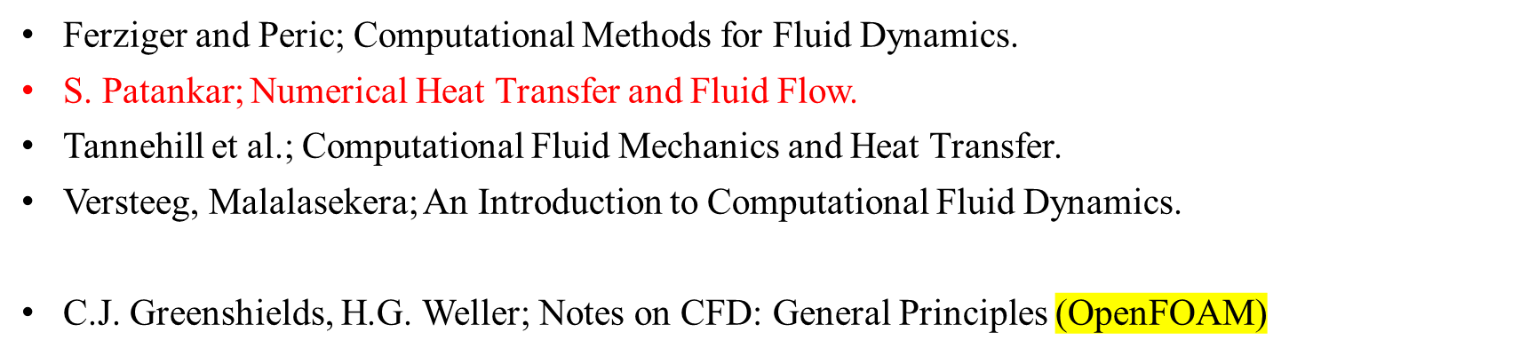
Introduction – References

Slide 6

CFD fundamentals – Fluid
A substance whose molecular structure offers no resistance to external forces - Ferziger, Peric
Fluid parcel
Fluid molecules

Slide 7












CFD fundamentals – Fluid
A substance whose molecular structure offers no resistance to external forces - Ferziger, Peric
Fluid parcel
Rotation
Expansion
Deformation

Slide 8





CFD fundamentals – Fluid
A substance whose molecular structure offers no resistance to external forces - Ferziger, Peric
Fluid parcel
Molecular
physics
Continuum
Fluid molecules

Slide 9


https://en.wikipedia.org/wiki/Knudsen_number#References
CFD fundamentals – Continuum
Knudsen number:
Kn < 0.01 | Continuum flow
0.01 < Kn < 0.1 | Slip flow
0.1 < Kn < 10 | Transitional flow
Kn > 10 | Free molecular flow
In physics, mean free path is the average distance over which a moving particle

Slide 11
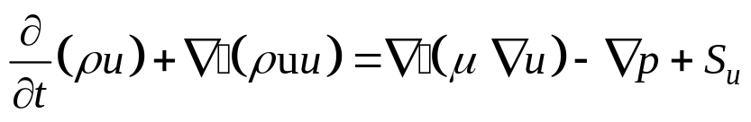
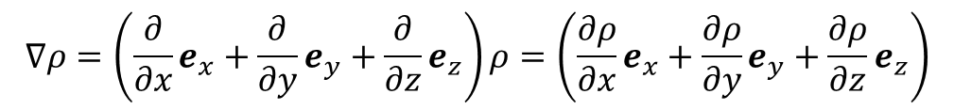

Mathematical operations
e_{y}
Gradient:
e_{x}
e_{z}
Notes:
https://www.youtube.com/watch?v=vWFjqgb-ylQ
The pressure gradient term in the Navier-Stokes equations is negative because the pressure force is acting in the opposite direction to the fluid flow. This term represents the force that drives the fluid in a particular direction. If the pressure is higher in one area of the fluid and lower in another, the fluid will flow from the high pressure area to the low pressure area

Slide 12
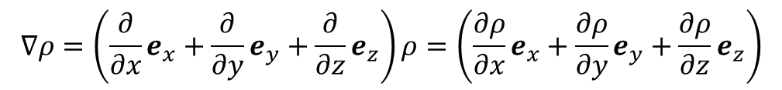
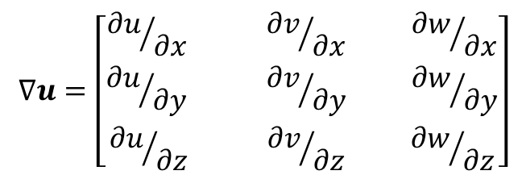
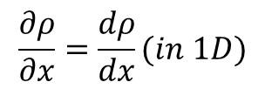
Mathematical operations
Gradient:
e_{y}
e_{x}
e_{z}

Slide 13
Mathematical operations
Divergence:
In vector calculus, divergence is a vector operator that operates on a vector field, producing a scalar field giving the quantity of the vector field's source at each point.
More technically, the divergence represents the volume density of the outward flux of a vector field from an infinitesimal volume around a given point.
As an example, consider air as it is heated or cooled. The velocity of the air at each point defines a vector field. While air is heated in a region, it expands in all directions, and thus the velocity field points outward from that region. The divergence of the velocity field in that region would thus have a positive value. While the air is cooled and thus contracting, the divergence of the velocity has a negative value.

Slide 15
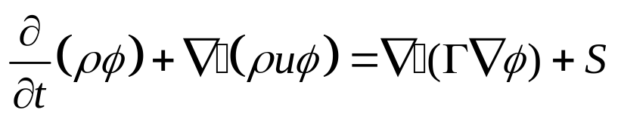
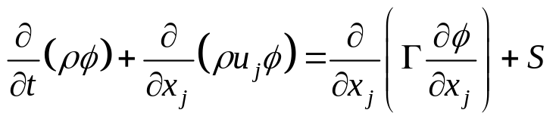
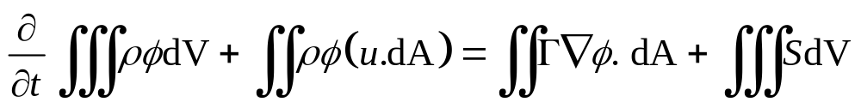
Governing Equations
The general equation can be written in the form as:
1
2
3
4
1
Unsteady/Transient term
3
Diffusion term
2
Advection/Convection term
4
Source term

Slide 16
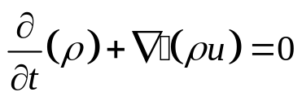


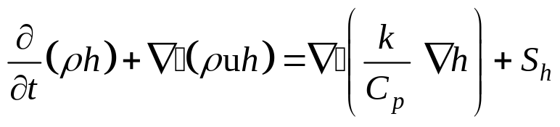


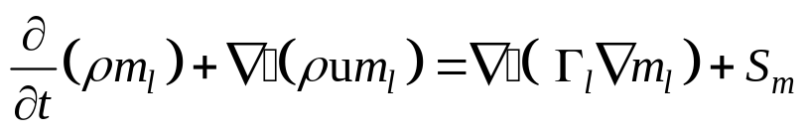
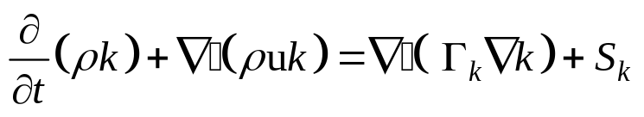


Governing Equations
Continuity equation:
➔
Momentum equation:
➔
Energy equation:
➔
Species equation:
➔
Turbulence equation:
➔
Ideal Gas equation:

Slide 17
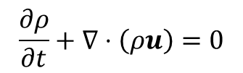
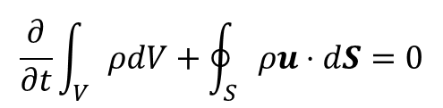










Finite Difference – Finite Volume
Differential form
Integral form
Notes:
This is where I want to introduce you to finite difference and finite volume approaches
Integral form: is in OpenFOAM
We will use differential form in Octave

Slide 19
What is OpenFOAM and importance ?
https://www.youtube.com/watch?v=r5ts2FLCA7U

Slide 20
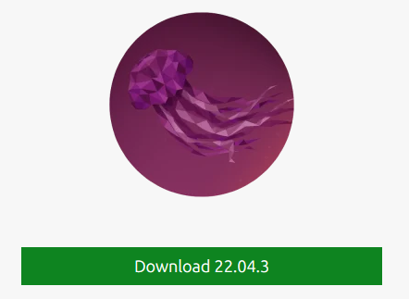



Installations
Preconfiguration packages:
  https://1drv.ms/f/s!AqT2YEB97-1RgP8MtsMPqoOGsq4ddg?e=IocXv0
List
  Virtual Box [to create virtual machines]
  Operating System: Ubuntu 22.04 [Install OpenFOAMv2306 & Octave]
  AnyDesk [For remote access]
  Create a github account:
    https://github.com/Kumaresh0402/ComputationalThermalEngineering
    Discussion forum:
      https://github.com/Kumaresh0402/ComputationalThermalEngineering/discussions

Slide 21
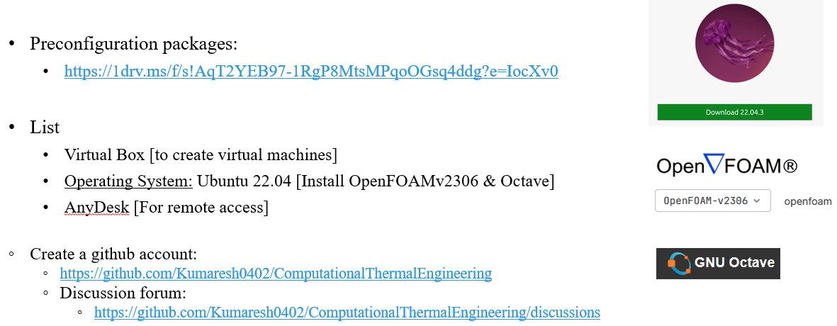
Exercise – 1 ➔ Install packages

